Slide 1
Lead Scoring : Presentation
~Nitya Narasimhan, Rajkumar Chandrasekaran

Slide 2
Problem statement
X Education sells online courses to industry professionals
The company markets its courses on several websites and search engines like Google. People landing on this website could be potential leads
The typical lead conversion rate at X education is around 30%, which is deemed poor
OBJECTIVE
X Education wishes to identify most promising leads, called as “Hot Leads”
The company wants to focus on elements that would help identify the “Hot Leads”
The typical lead conversion rate at X education should aim at around 80%, and a futuristic model to be built which is easily scalable for future as well

Slide 3
Solution method
Take the leads dataset from the past which has around 9000 data points
Check and handle duplicate data, missing values, impute values as needed
Drop columns and variables, that contain around 70%+ empty values – as they wouldn’t add anything significant
Handle any outliers
Complete the Exploratory Data Analysis:
Have a univariate data analysis, distribution of variables, etc
Feature scaling, Dummy variables, and one-hot encoding of categorical variables
Building model using logistic regression
Check for accuracy, sensitivity and specificity

Slide 4
What did we arrive at?
We arrived at a train and test model combination, with the below accuracy, sensitivity and specificity for your consumption
Let us compare the values obtained for Train & Test:
Train Data:
Accuracy : 91%
Sensitivity : 86%
Specificity : 94%
Test Data:
Accuracy : 91%
Sensitivity : 84%
Specificity : 94%

Slide 5
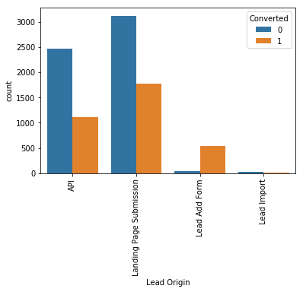
Some significant contributors…
Some specific variables have a significant impact on the “Lead Conversion” ratio, compared to other variables. Let’s look at some of these variables
Lead Origin
Inference:
API and Landing Page Submission have 30-35% conversion rate but count of lead originated from them are considerable.
Lead Add Form has more than 90% conversion rate but count of lead are not very high.
Lead Import are very less in count.

Slide 6
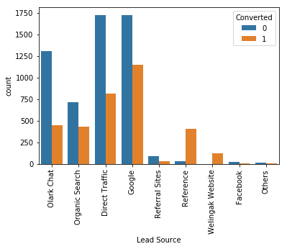
Some significant contributors…
Lead Source
Inference:
Google and Direct traffic generates maximum number of leads

Slide 7
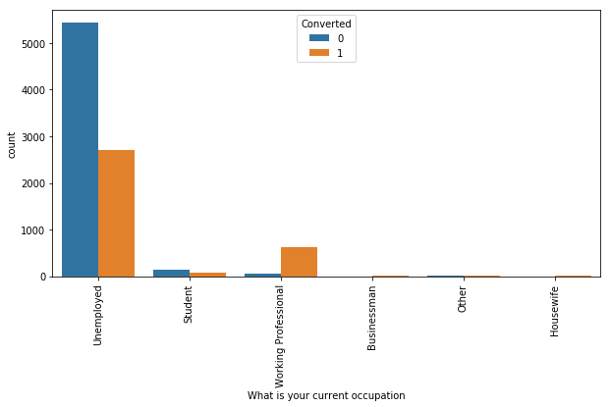
… significant contributors (CONTD.)
Occupation
Inference:
Unemployed leads are the most in numbers but has around 30-35% conversion rate.
Working Professionals going for the course have high chances of joining it.

Slide 8
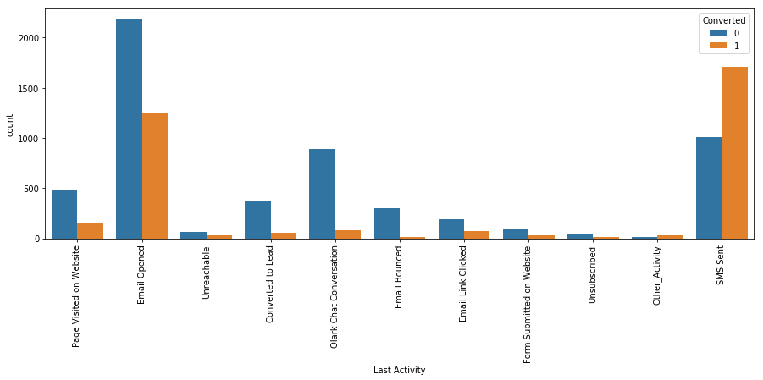
… significant contributors (CONTD.)
Last Activity
Inference:
Conversion rate for leads with last activity as SMS Sent is almost 60%.
Most of the lead have their Email opened as their last activity.

Slide 9
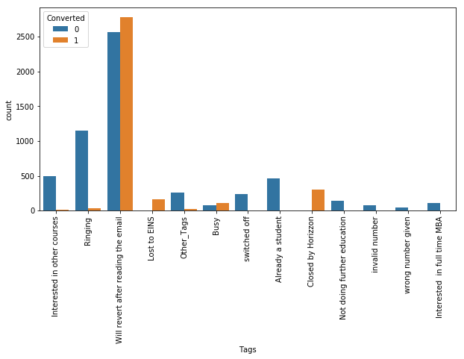
… significant contributors (CONTD.)
Tags
Inference:
"Will revert after reading the email" has more leads converted to 1

Slide 10
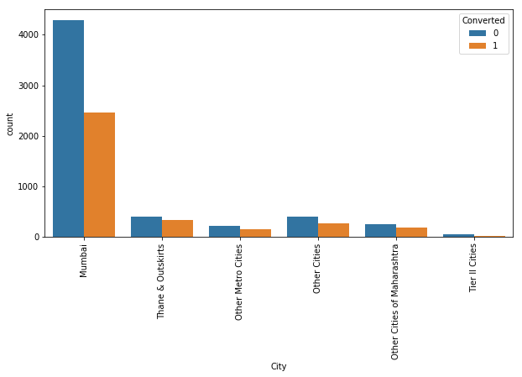
… significant contributors (CONTD.)
City
Inference:
Mumbai has around 30% lead conversion compared to other cities
Based on the univariate analysis we have seen that many columns are not adding any information to the model, so we can drop them for further analysis**

Slide 11
Data conversion
Numerical variables were normalised
Binary variables with Yes/No were converted to 1/0
Categorical variables with more than 2 categories were converted to dummy variables (one hot encoding)
Post normalisation, around 9074 rows and 16 columns were taken for final consideration

Slide 12
MODEL building
Split the data into training and test sets, with 70:30 data split for train:test respectively
Use RFE for feature selection
Running RFE with 15 variables
Building model by removing the variable with p-value > 0.05 and VIF > 5
Run predictions on train data set to gauge accuracy, sensitivity and specificity
Run predictions on test data set to gauge accuracy, sensitivity and specificity
Compare the results for final observation and conclusion

Slide 13
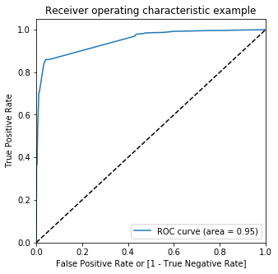
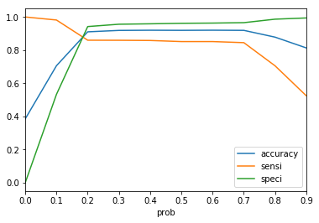
ROC Curve and AUC
Finding optimal cut-off point
Probability where we get balanced sensitivity and specificity
From the second graph the optimal cut-off point is at 0.2

Slide 14
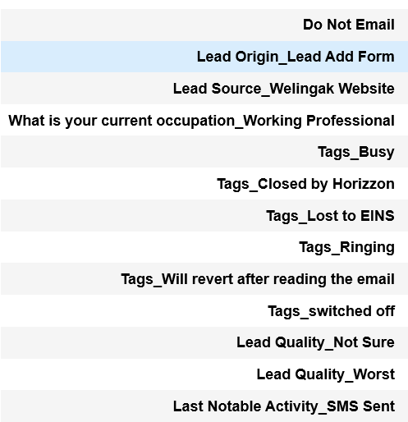
conclusion
The variables on the right have been accounted for to build the train and test model
These variables have a significant impact on the lead conversion ratio
With the variables, we’ve arrived at an accuracy rate of 91%
** pls refer the python notebook for further detailed analysis

